Slide 1








Lesson 1. Angular Component Input Properties

Slide 2
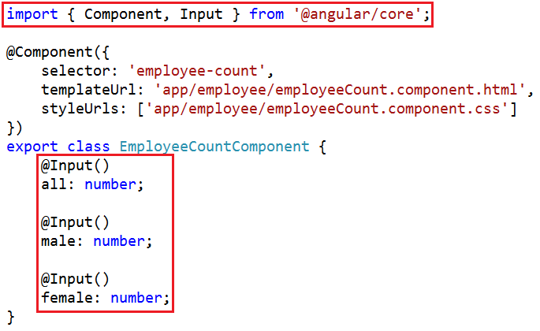
Angular Component Input Properties
To make a property an input property decorate it with @Input decorator

Slide 3
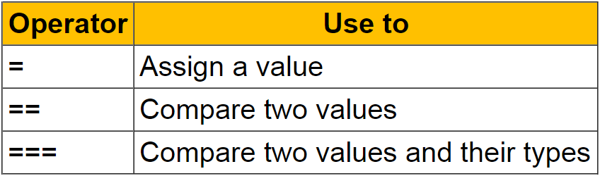
Angular Component Input Properties

Slide 4
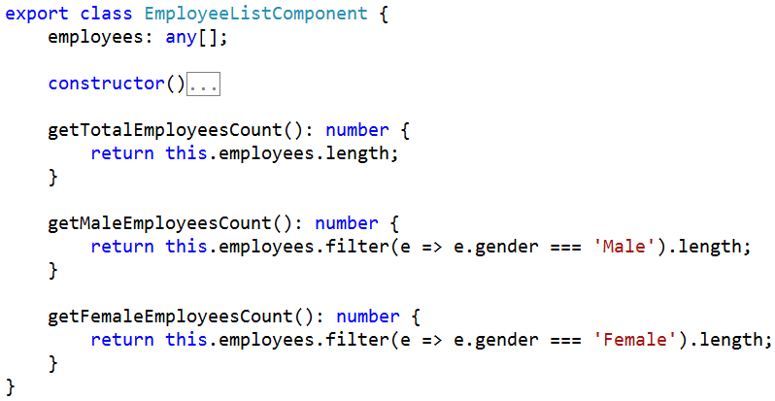
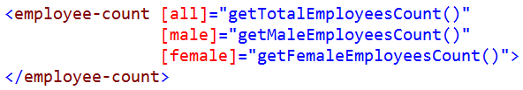
Angular Component Input Properties

Slide 5
Q & A
Contact:rashmipawaskar@synergetics-india.com

Slide 6
Thank You

